Slide 1
Paytm
https://projects.100xdevs.com/tracks/oAjvkeRNZThPMxZf4aX5/JLaLbhDuYn3h5Cn7WJu1

Slide 2
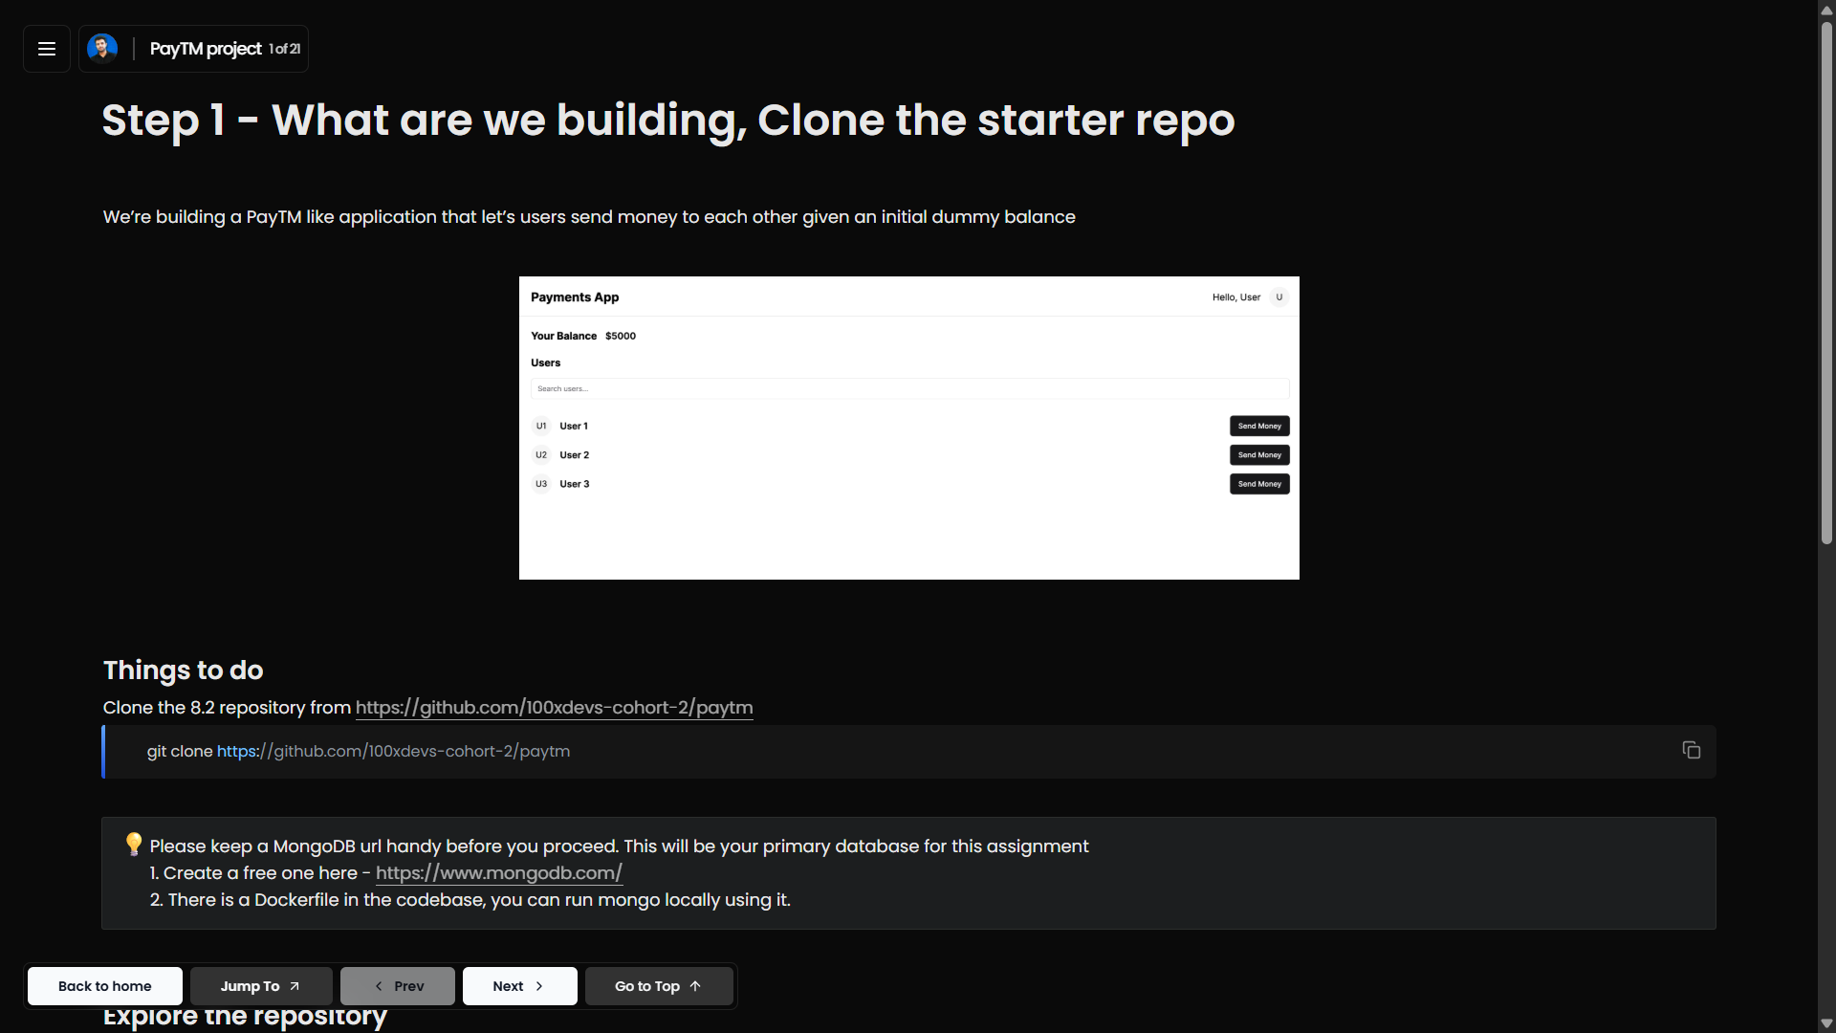



Slide 3
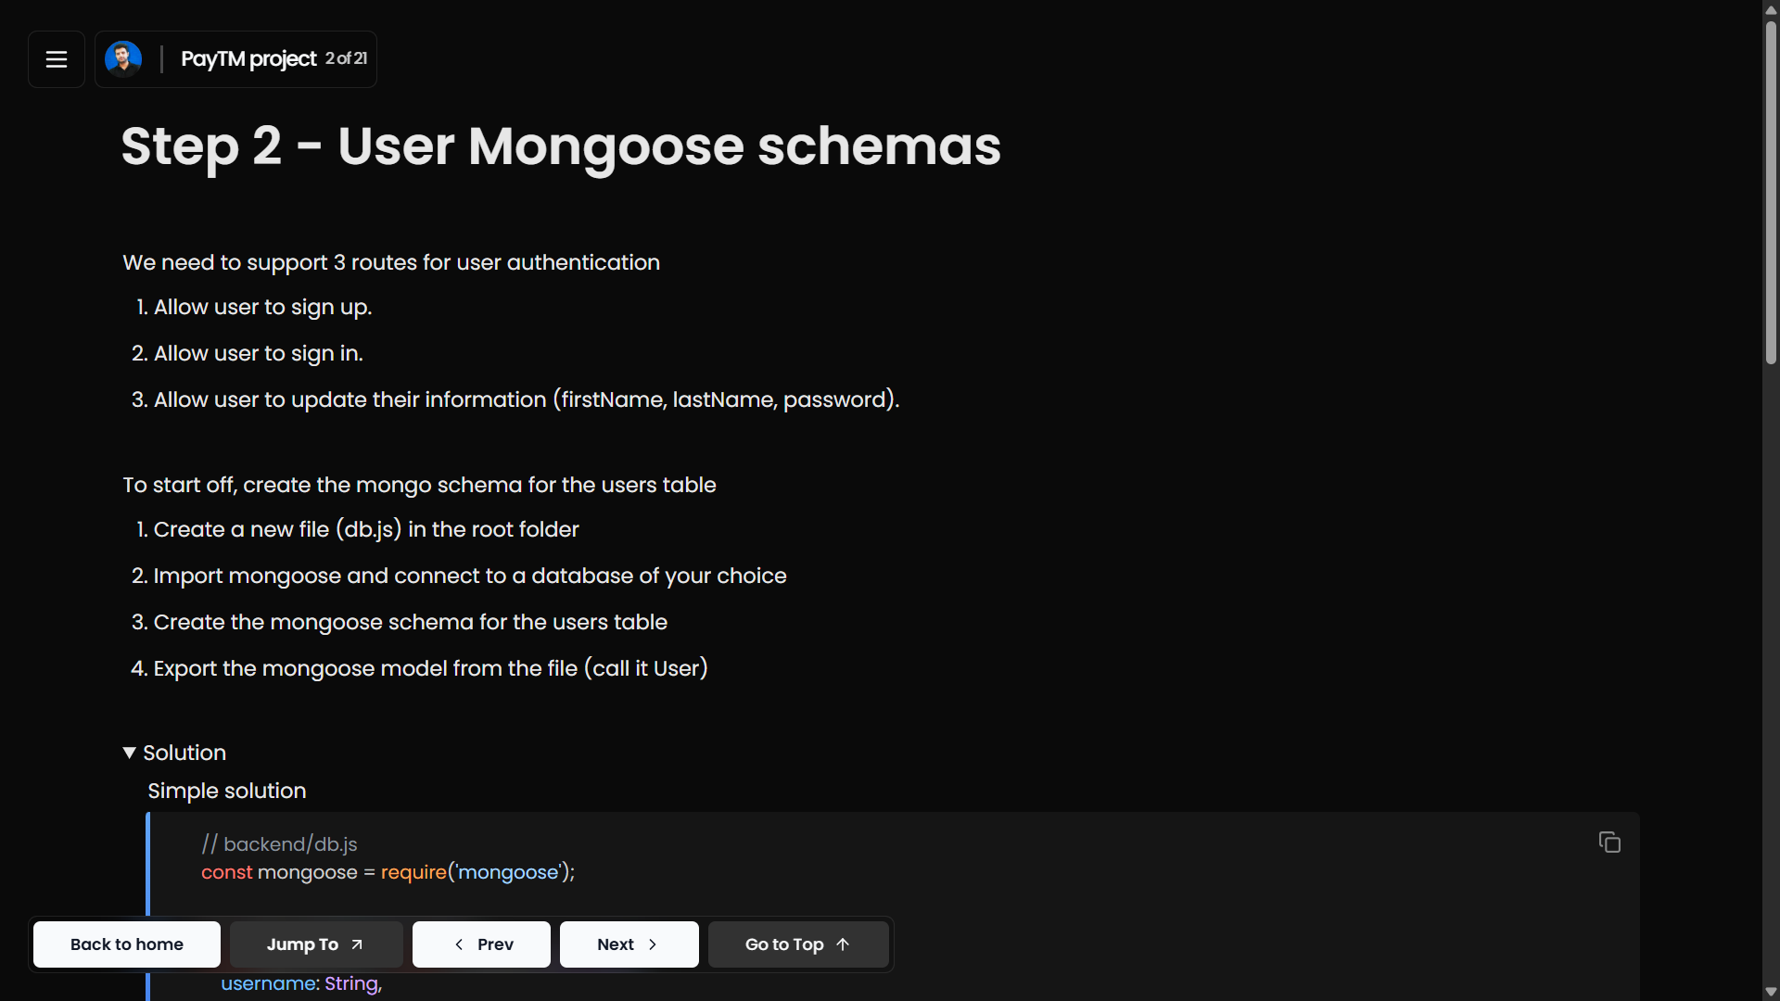

Slide 4
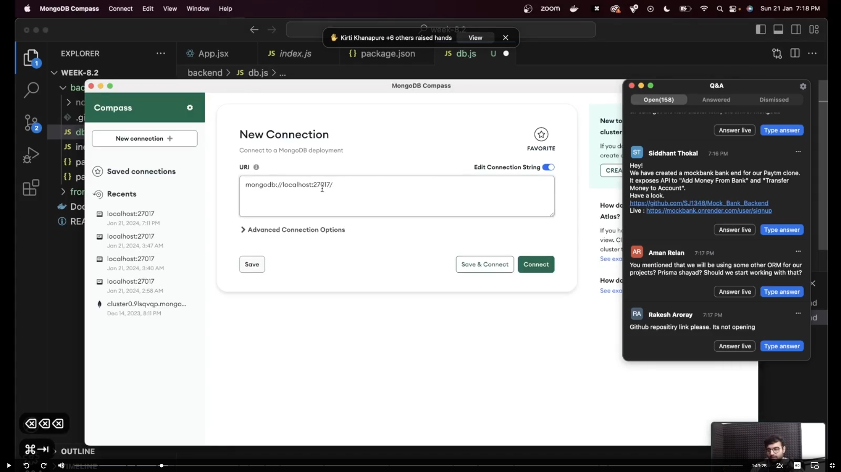

Slide 5
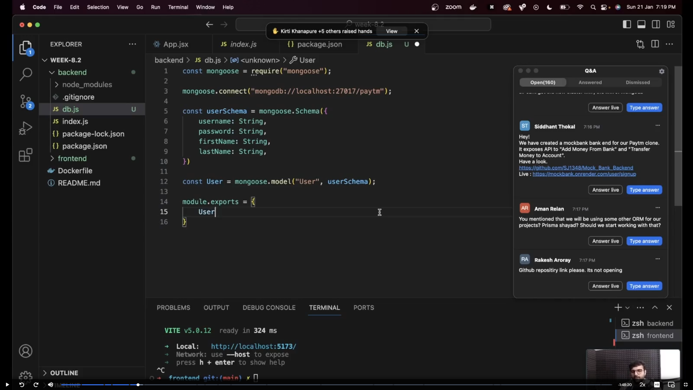

Slide 6
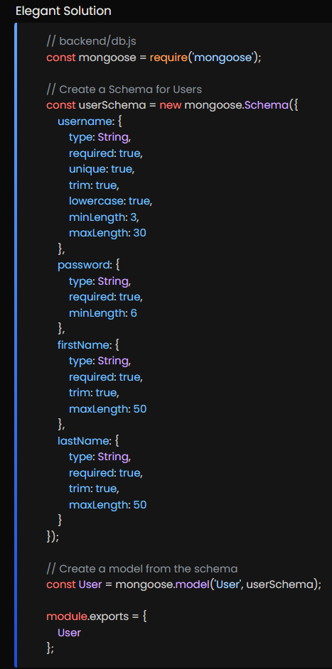
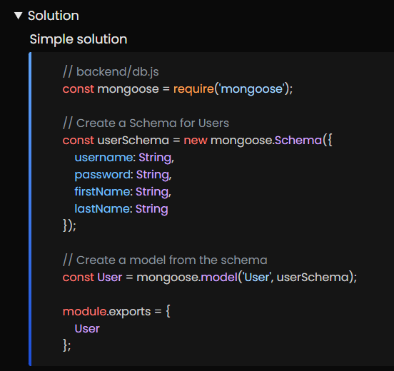

Slide 7
